Slide 1
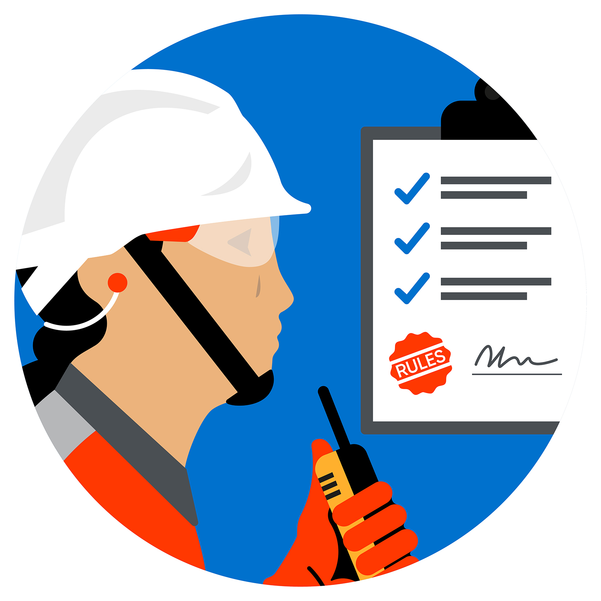
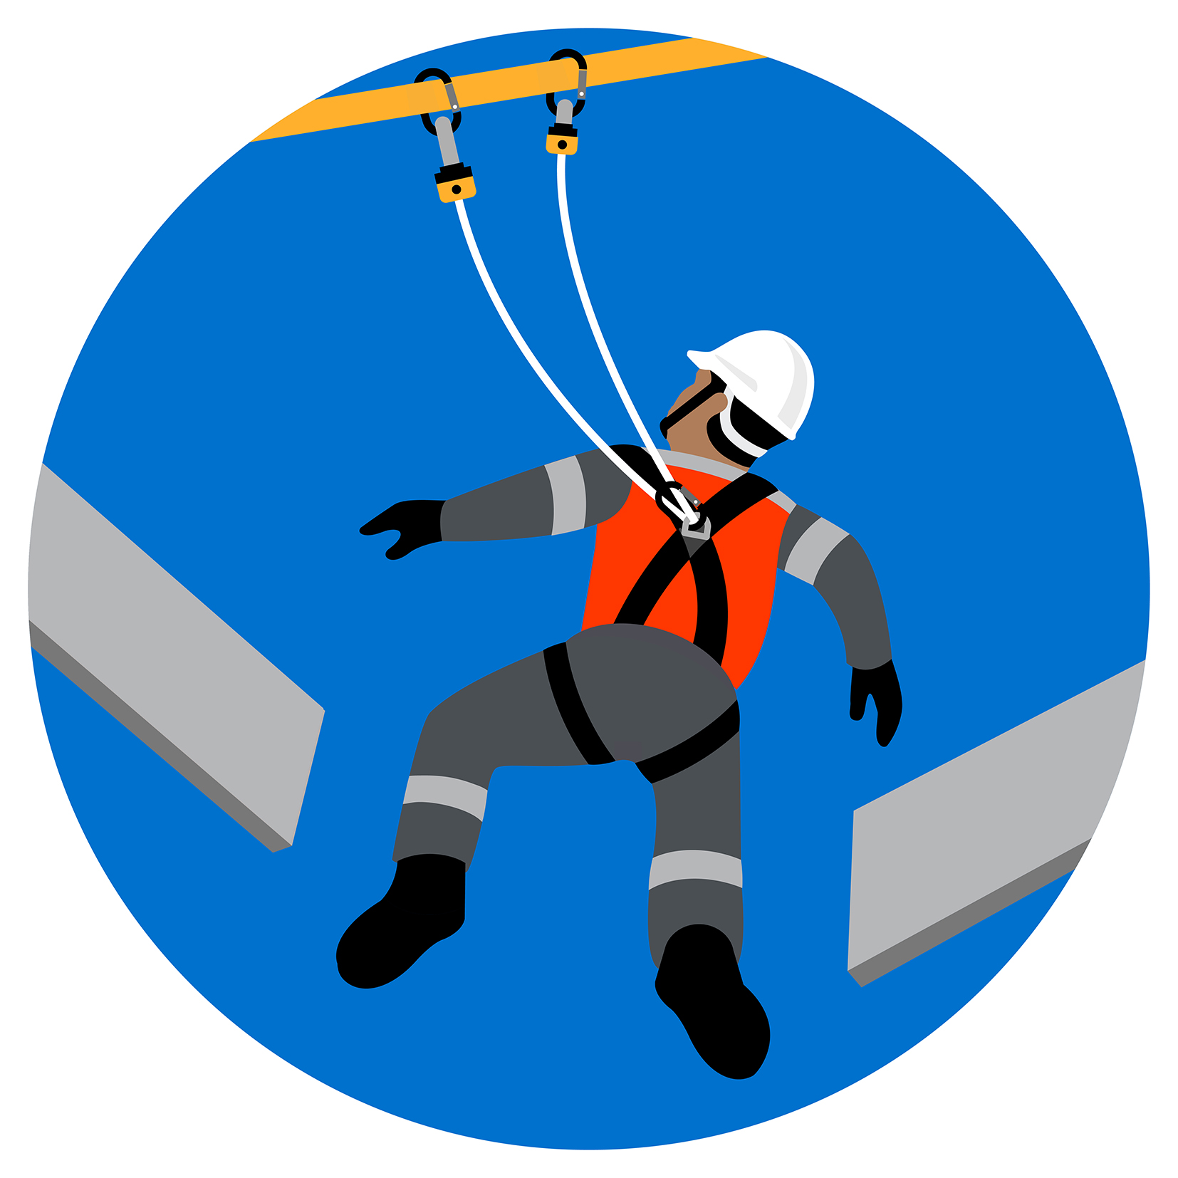
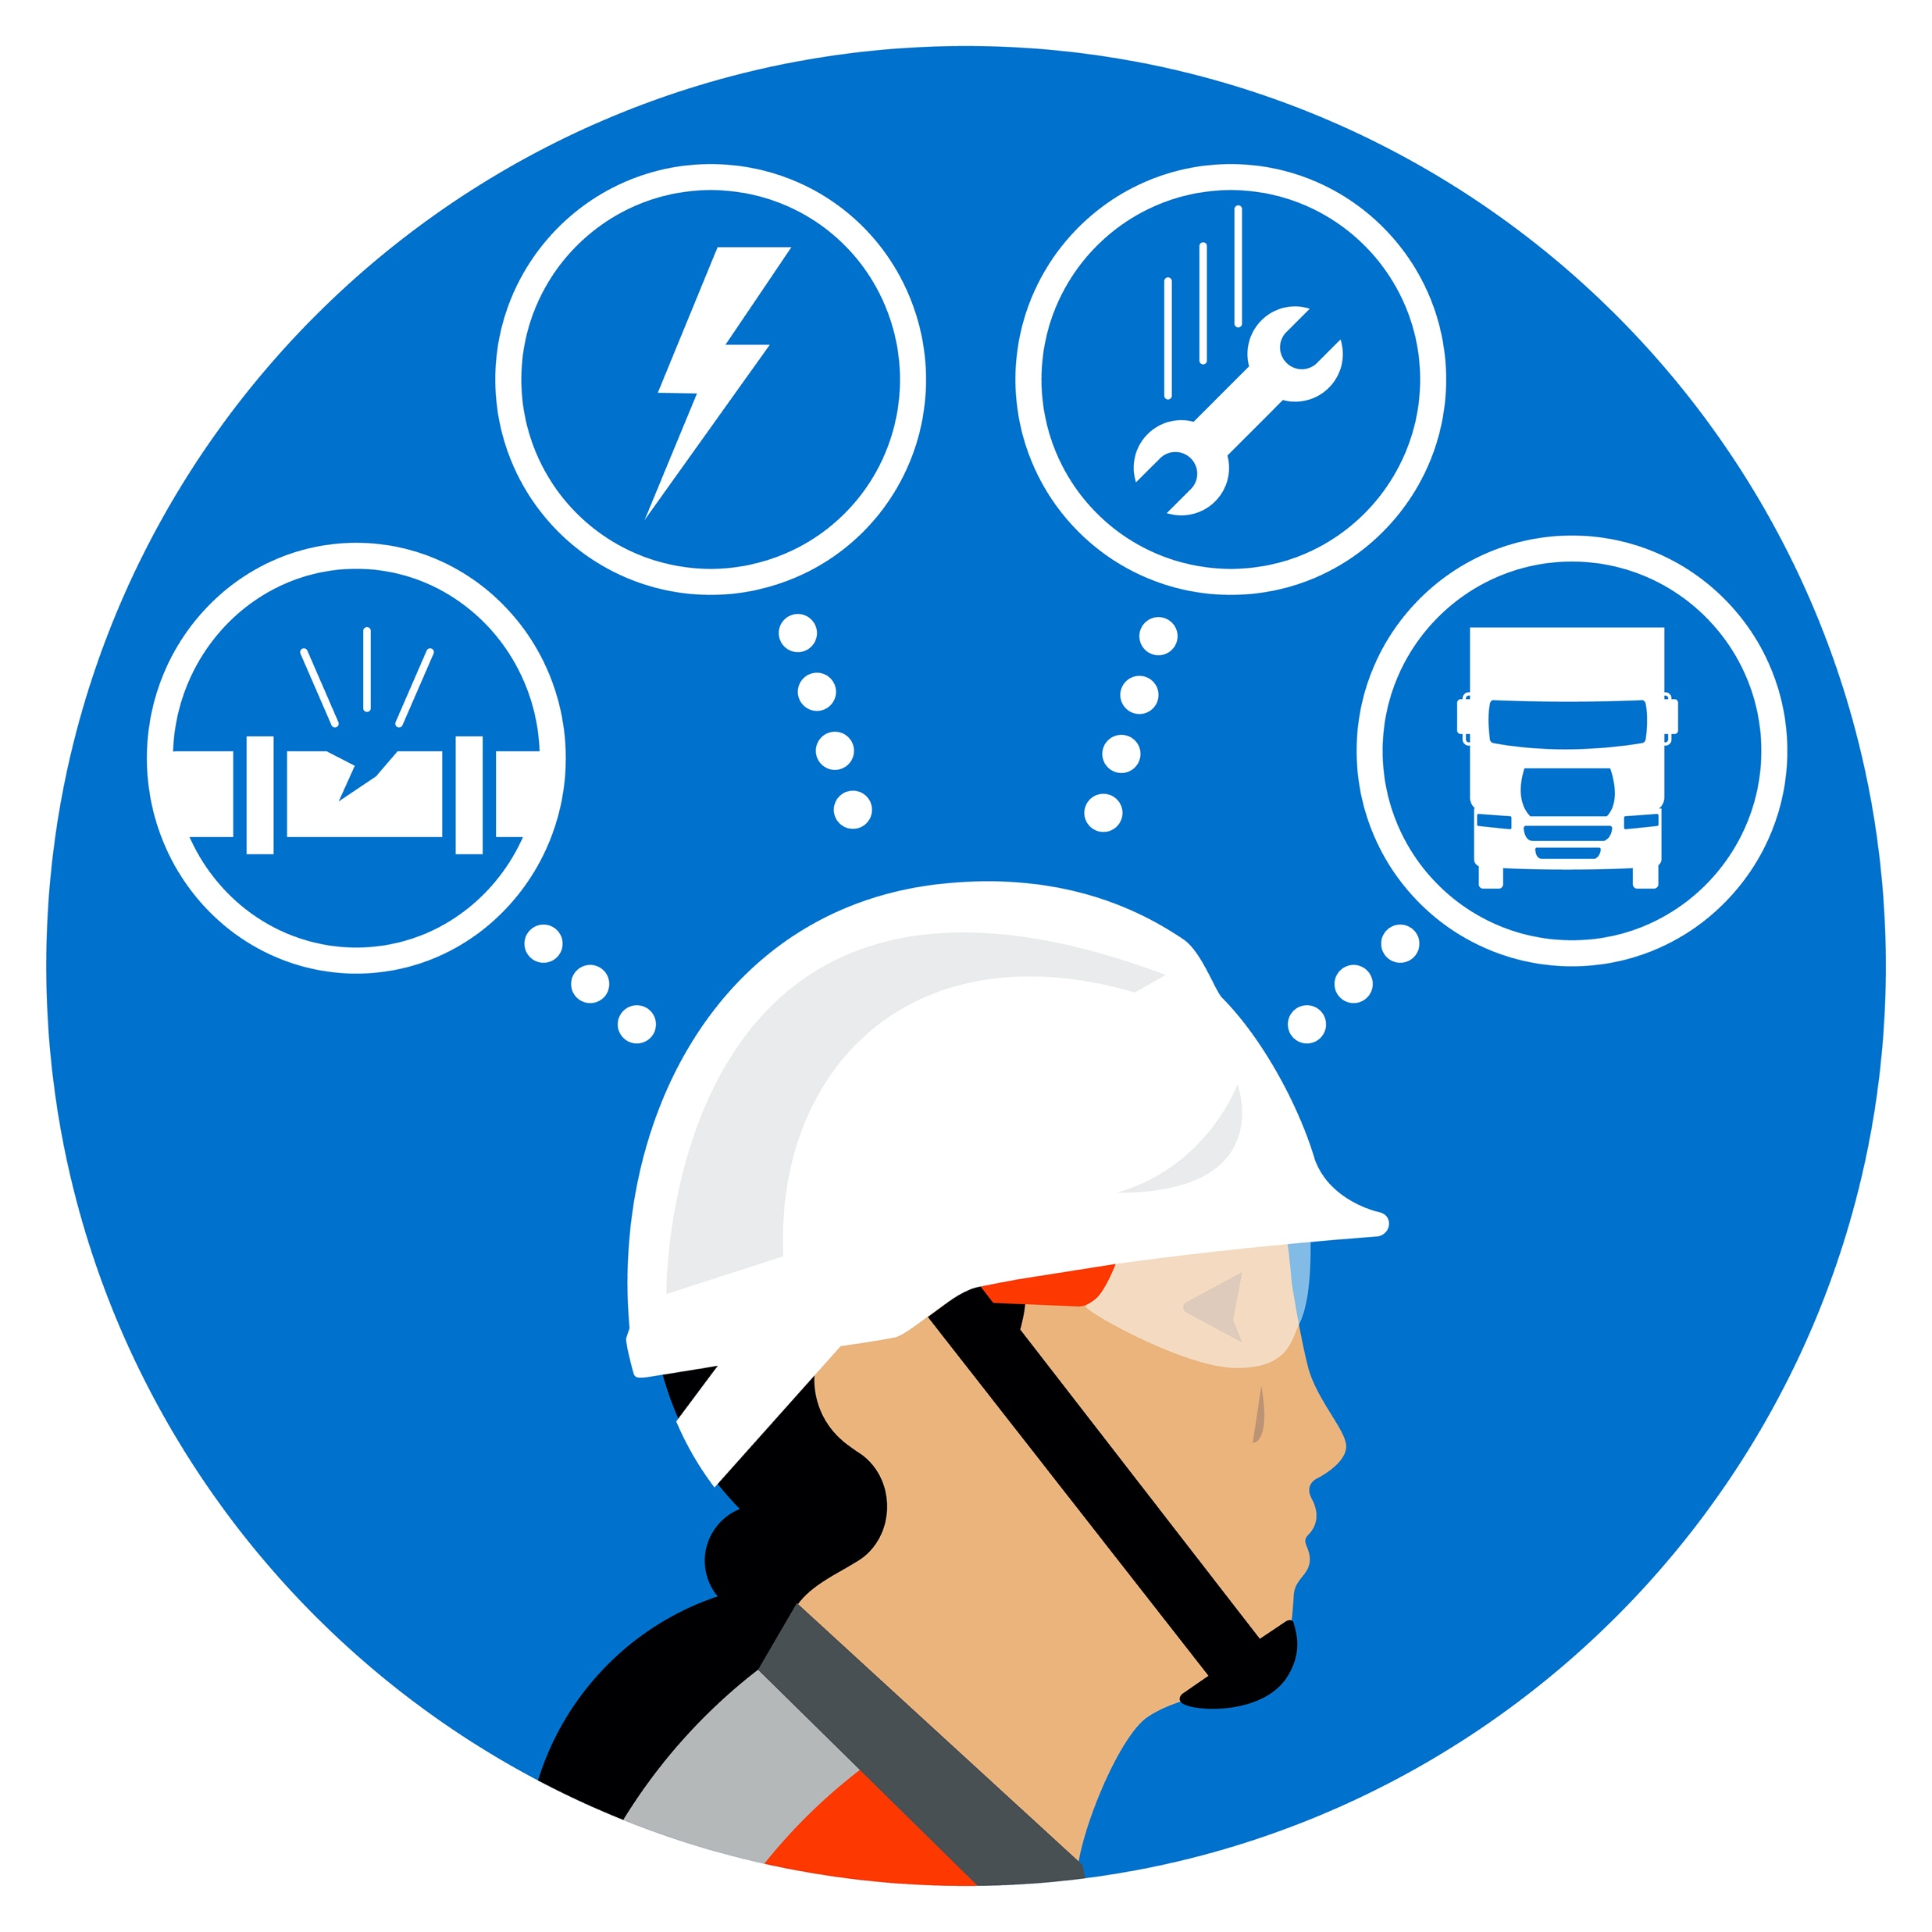
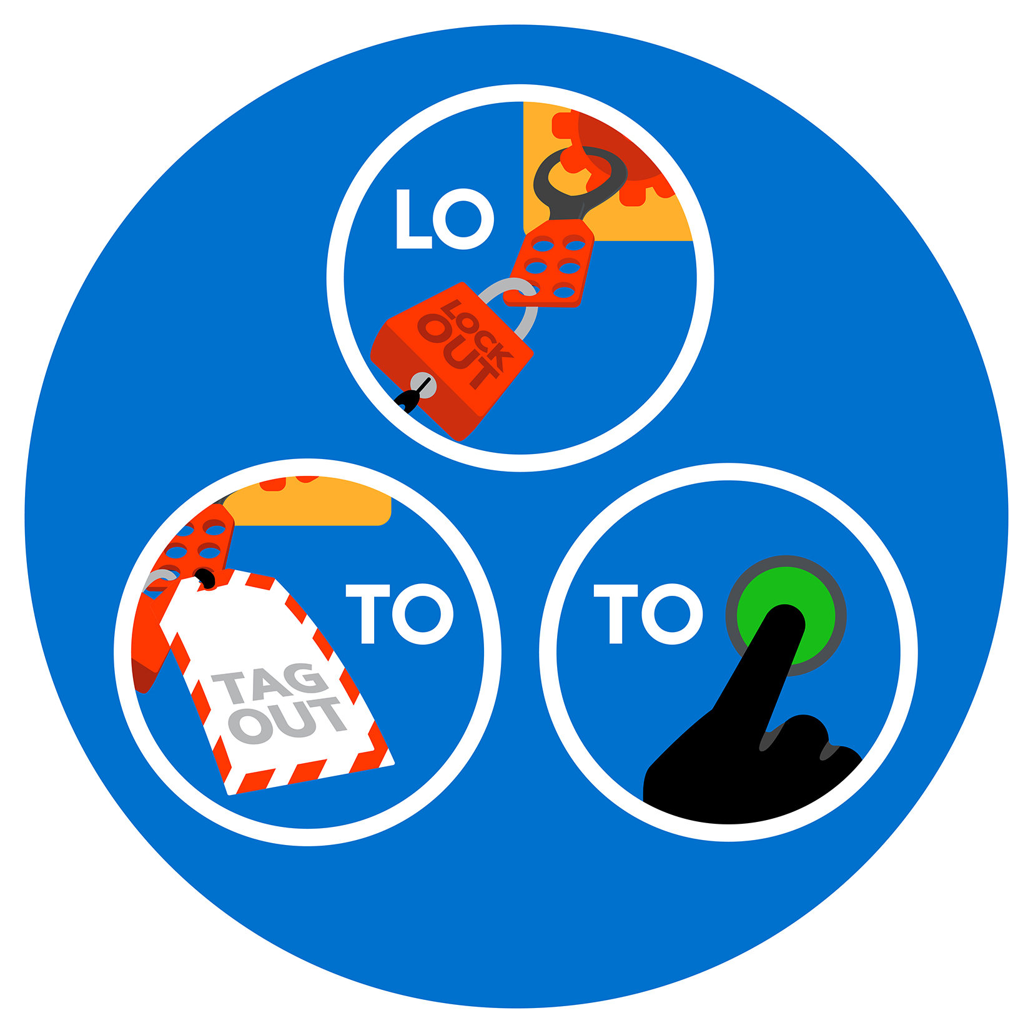
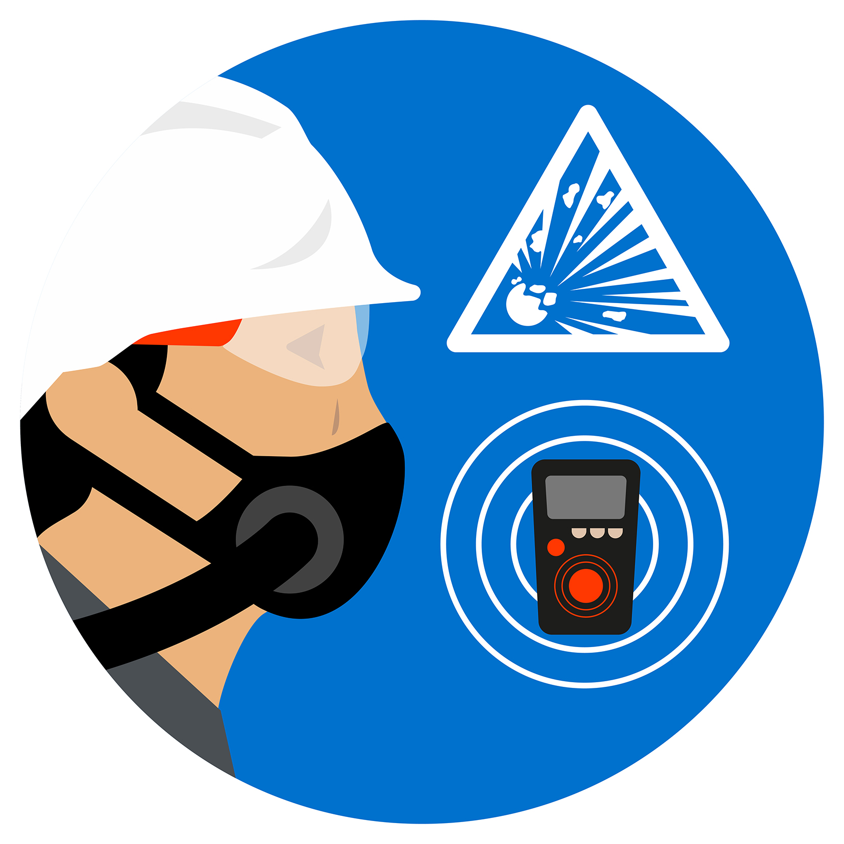
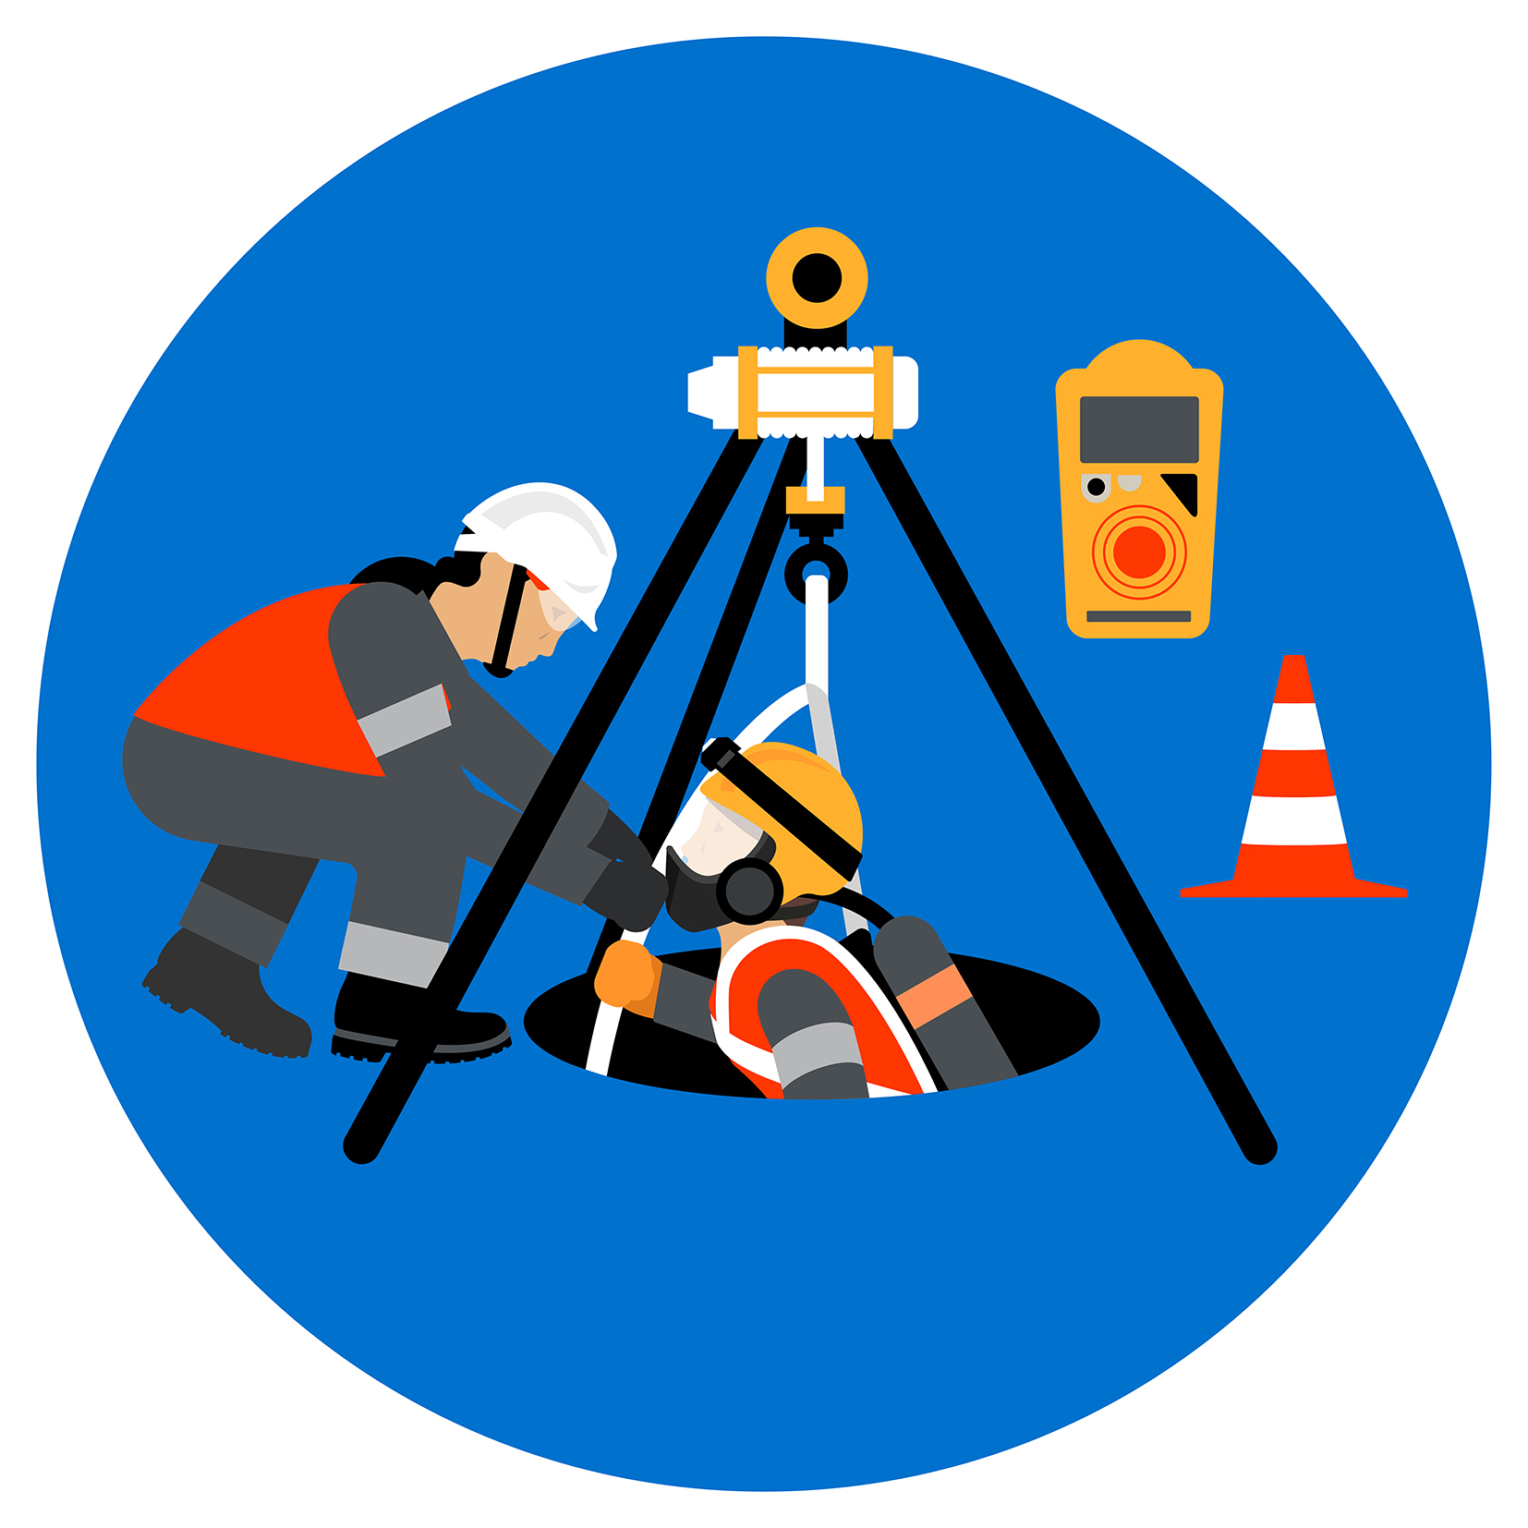
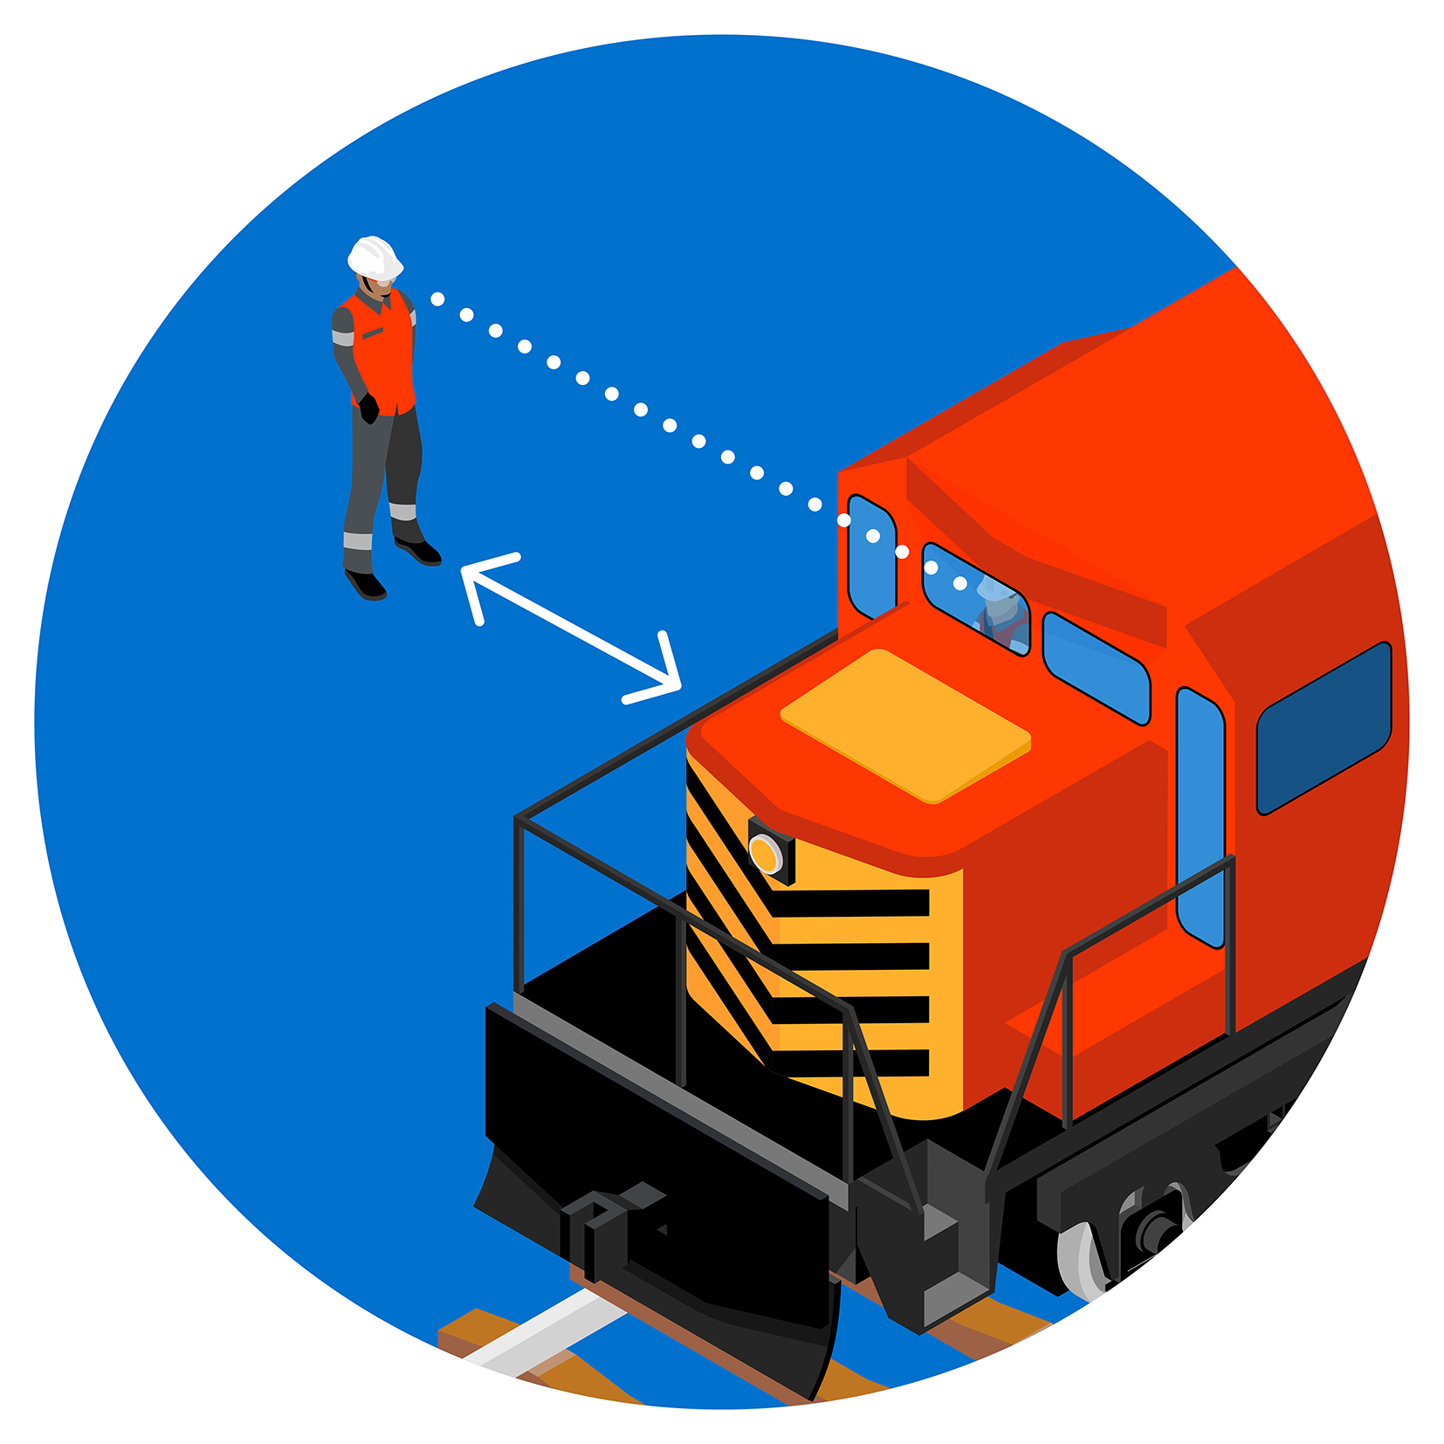
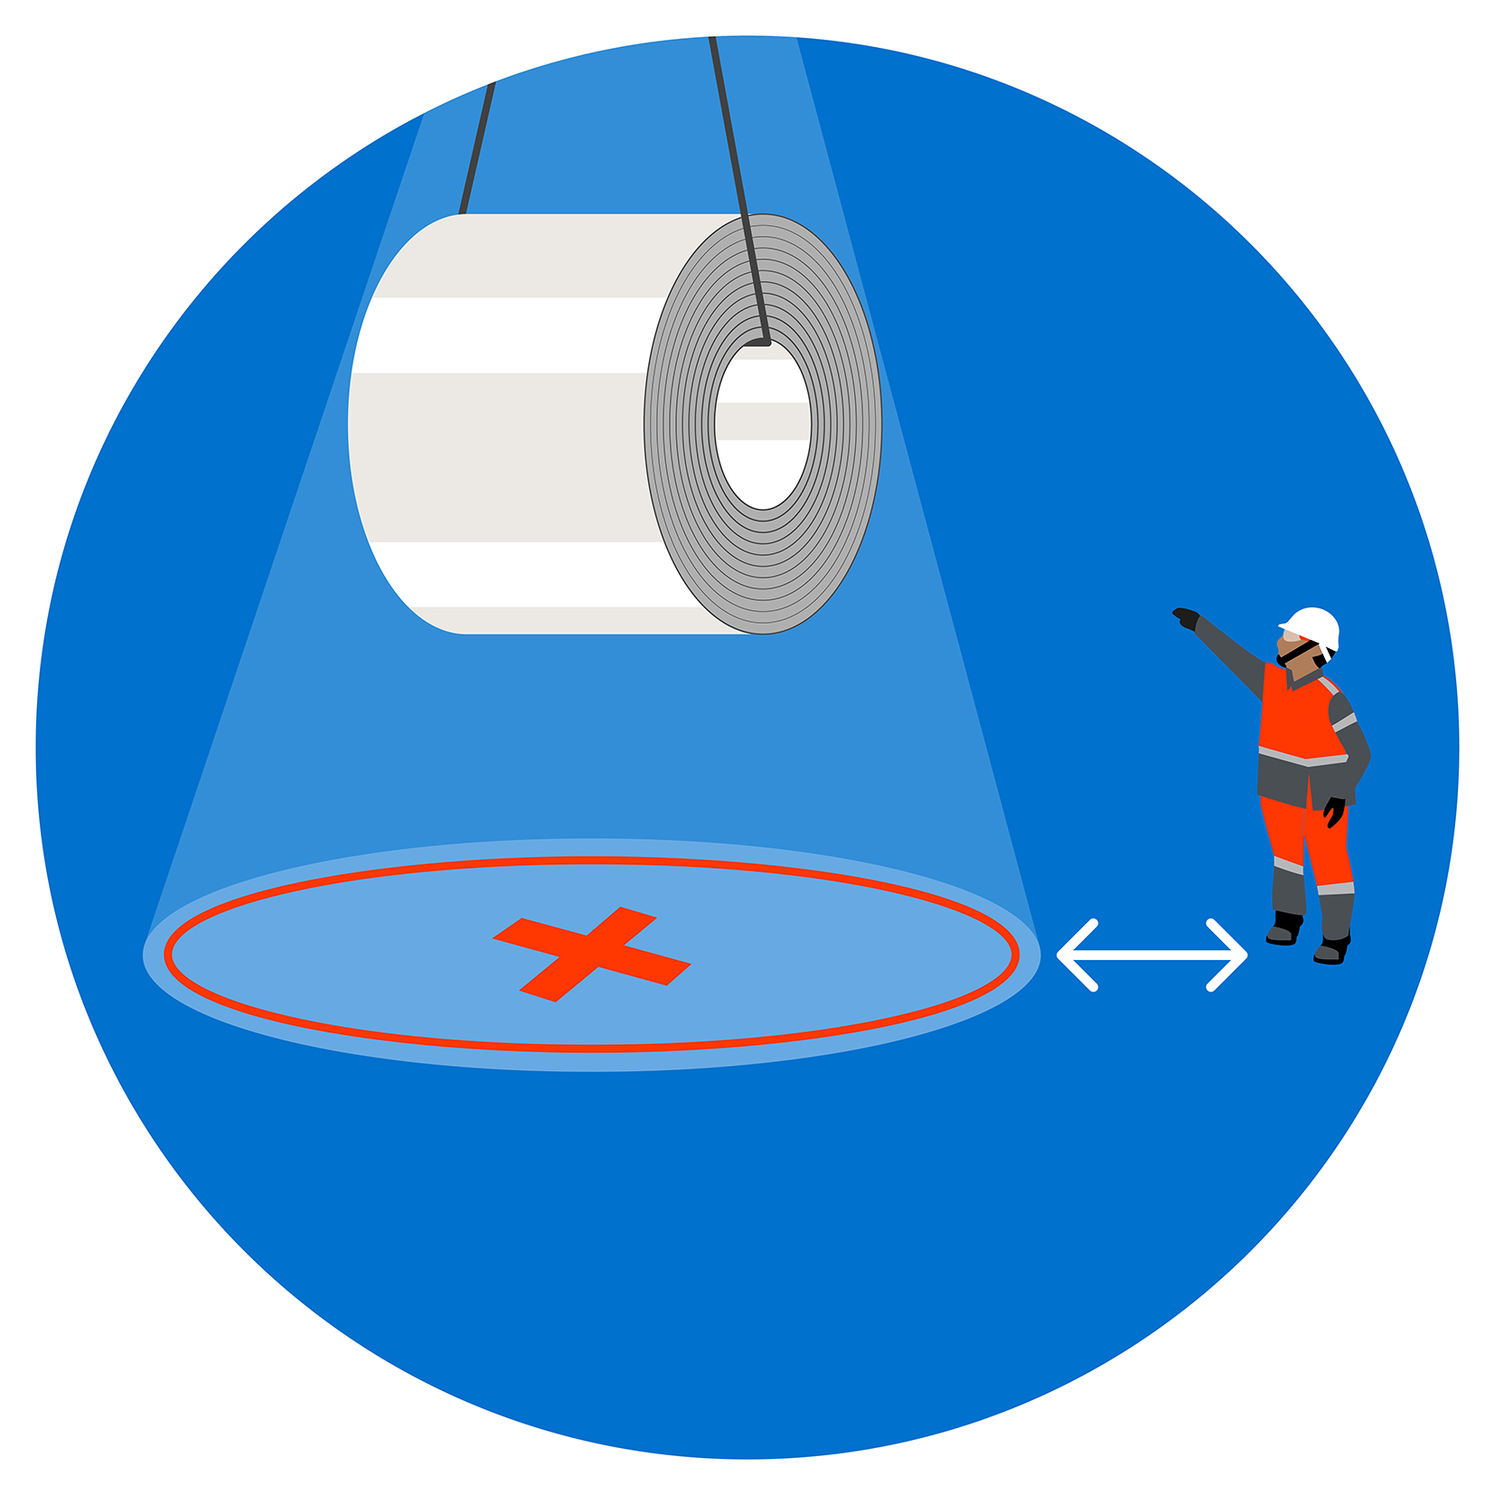
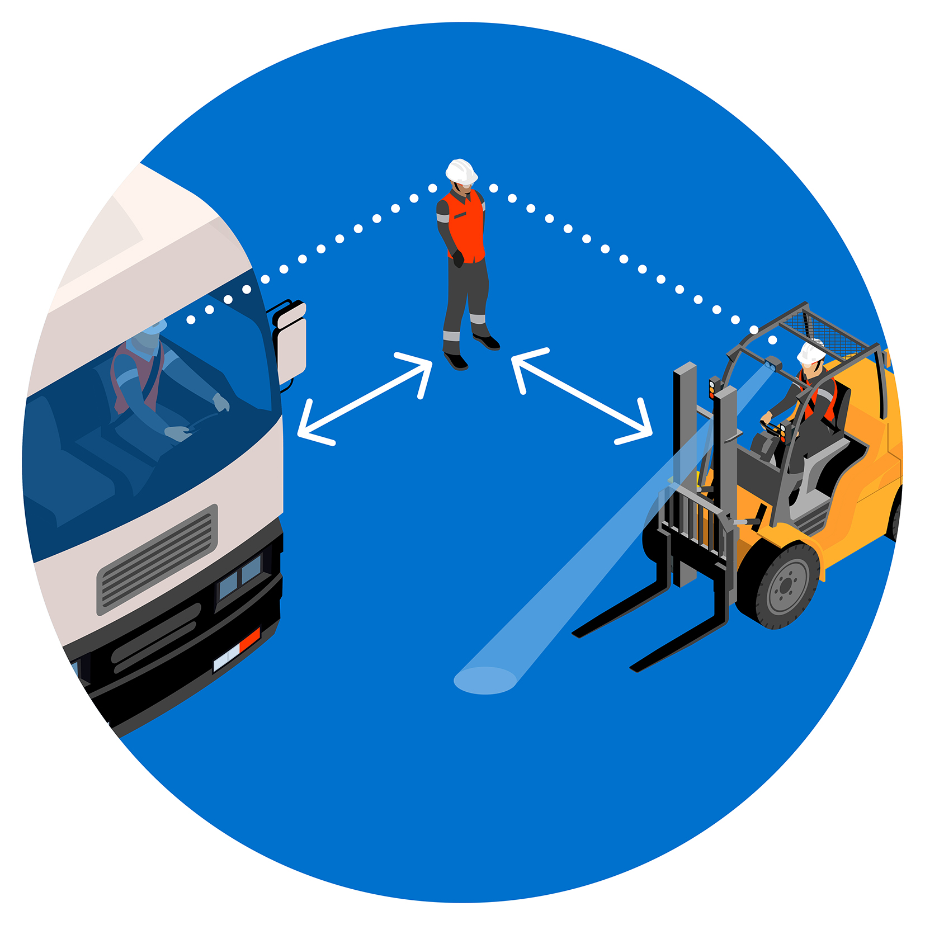
Life Saving Golden Rules
Respect them to stay alive
I work in a “fit and able” condition
I use fall prevention or protection when the risk of falling is beyond 1.8 m
I follow the isolation procedure
I follow the confined space procedure
I respect all the rules of load handling and never stand under a suspended load
I respect all the traffic and driving rules
I respect rail priority and stay out of close clearance areas
I respect the rules for entering and working in hazardous gas areas
I never disable safety devices
I respect all the H&S basic rules, standards and signals and I wear the required PPE

Slide 2
Life Saving Golden Rules
Respect them to stay alive
I work in a “fit and able” condition
Involved in 2 fatal events since 2017
Practical examples of expected behaviours:
I work free from the influence of alcohol, drugs (illegal or legal)
If I take some medication impacting my alertness, I talk to my occupational physician
I speak up to my colleagues and leader if I feel unwell, over-stressed or if time pressure is beyond my ability to work safe
I pay attention to my colleagues’ condition

Slide 3
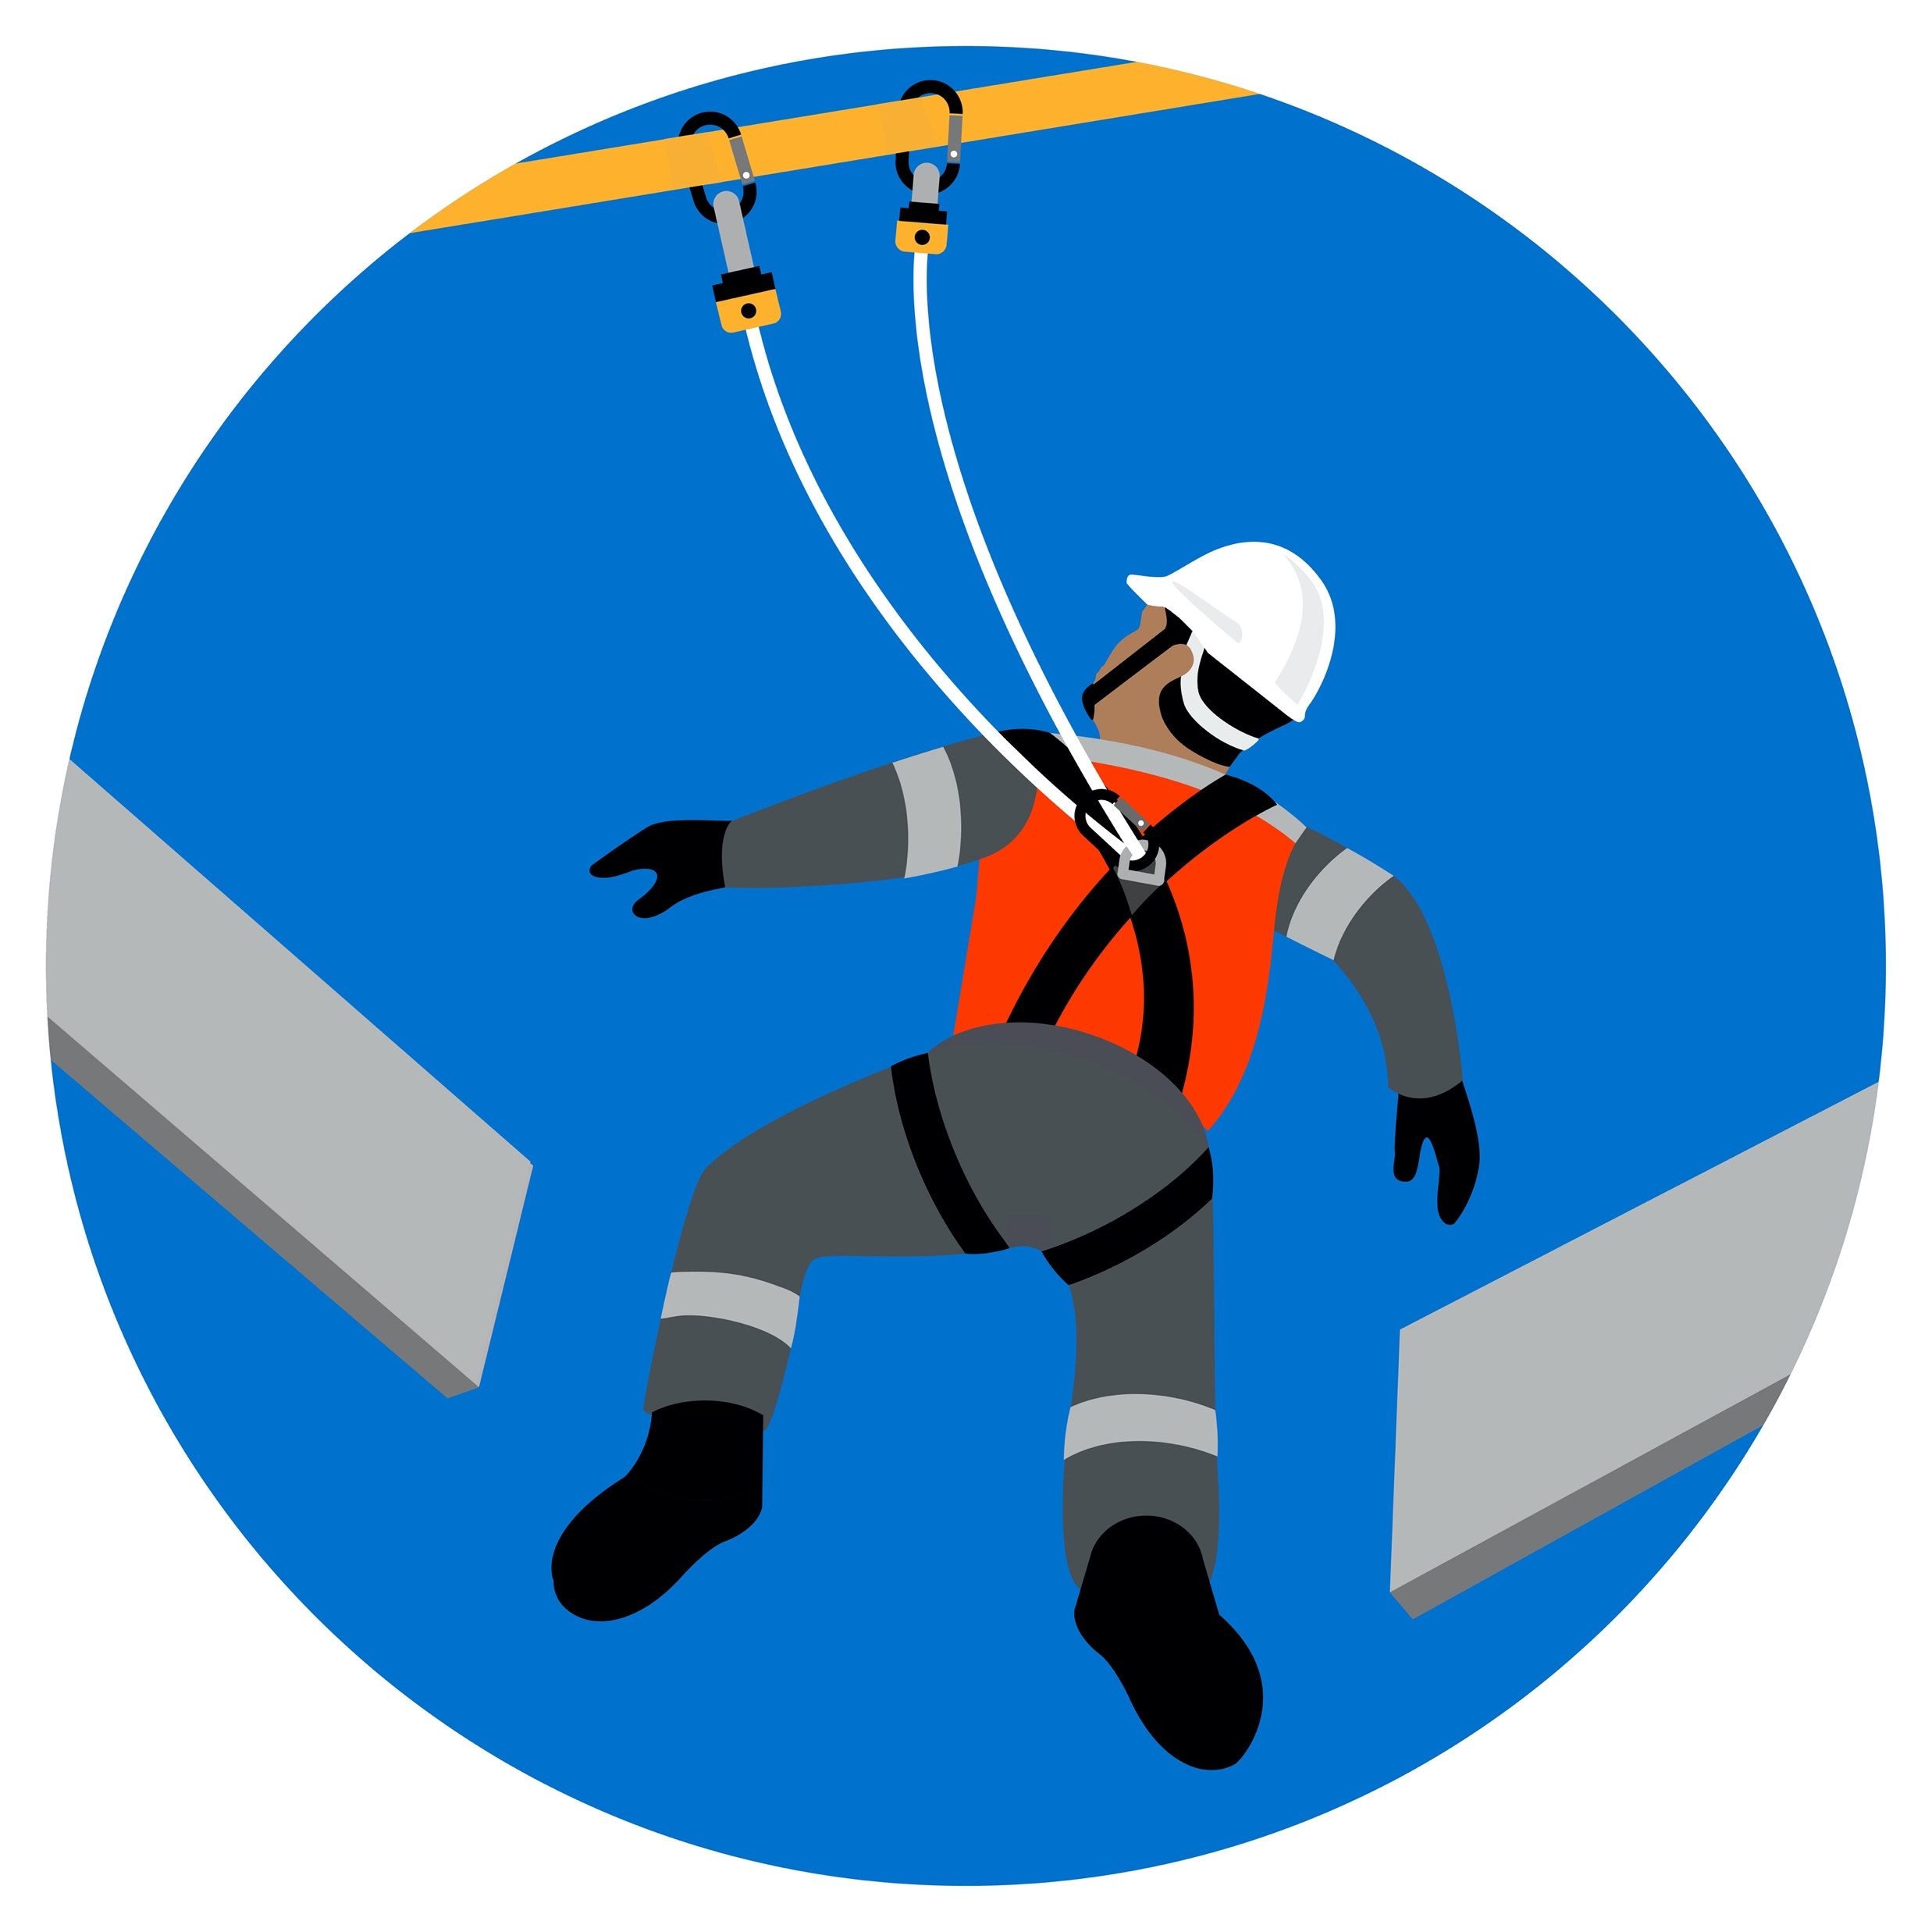
Life Saving Golden Rules
Respect them to stay alive
I use fall prevention or protection when the risk of falling is beyond 1.8m
Involved in 12 fatal events since 2017
Practical examples of expected behaviours:
I understand and identify working at height hazards, including but not limited to roofs, fragile or poorly-guarded structures, floor opening and water along docks
I understand and sign off the risk analysis. I apply all its foreseen controls, 100%, at all times
In particular, I tie off 100% to approved anchor points while outside a protected designated area
I keep my chinstrap clipped

Slide 4
Life Saving Golden Rules
Respect them to stay alive
I follow the isolation procedure
Involved in 18 fatal events since 2017
Practical examples of expected behaviours:
I respect isolation requirements prior to working on any piece of equipment
b. I follow isolation procedures, step by step
c. I understand and respect the 3 phases of the Lock Out – Tag Out – Try Out isolation process
In particular:
• I put my personal lock on the identified element (lockbox): 1 person – 1 key – 1 lock
• I check dissipations of residual energies or have them checked by a competent person
If it is absolutely necessary to work on equipment under no or partial isolation (for example, for fault diagnosis), I obtain written authorisation from my leader, perform a specific risks analysis and respect all its controls

Slide 5
Life Saving Golden Rules
Respect them to stay alive
I follow the confined space procedure
Not involved in a fatal event since 2017 (involved several times before 2015)
Practical examples of expected behaviours:
I understand and identify confined spaces hazards
I am trained and I receive a specific work permit before entering the confined space
I understand and use the controls foreseen by the risks analysis, at all times
In particular, I do not enter a confined space without an individual gas detector, and will keep it continuously operational, or, when required, an autonomous respiratory device
I understand and respect gas detector alarms and corresponding evacuation rules

Slide 6
Life Saving Golden Rules
Respect them to stay alive
I respect all rules of load handling and never stand under a suspended load
Involved in 9 fatal events since 2017
Practical examples of expected behaviours:
I understand and identify suspended loads and gravity energy hazards
I respect all the rules of load rigging and handling. In particular, I use tag line or no touch tools for load guiding when needed
I never put myself between a suspended load and a fix point, as the load might move unexpectedly or in an unanticipated direction
I move away from the load BEFORE starting the lifting
I never stay within the safety cone of a suspended load. When not possible, I understand and respect all the controls foreseen by the specific risks analysis
I never go under or near a supported piece of equipment that has not been secured in a safe engineered way and might therefore fall/collapse

Slide 7
Life Saving Golden Rules
Respect them to stay alive
I respect all traffic and driving rules
Involved in 13 fatal events since 2017
Practical examples of expected behaviours:
I understand and identify vehicle hazards
I respect the separation of pedestrians and vehicles at all times
I understand blind spot hazards and stay away from large vehicles at all times
I respect all traffic rules, in particular, I always wear the safety belt when I am in a vehicle
I never drive without proper visibility
I double check the application of my parking brake before leaving my vehicle

Slide 8
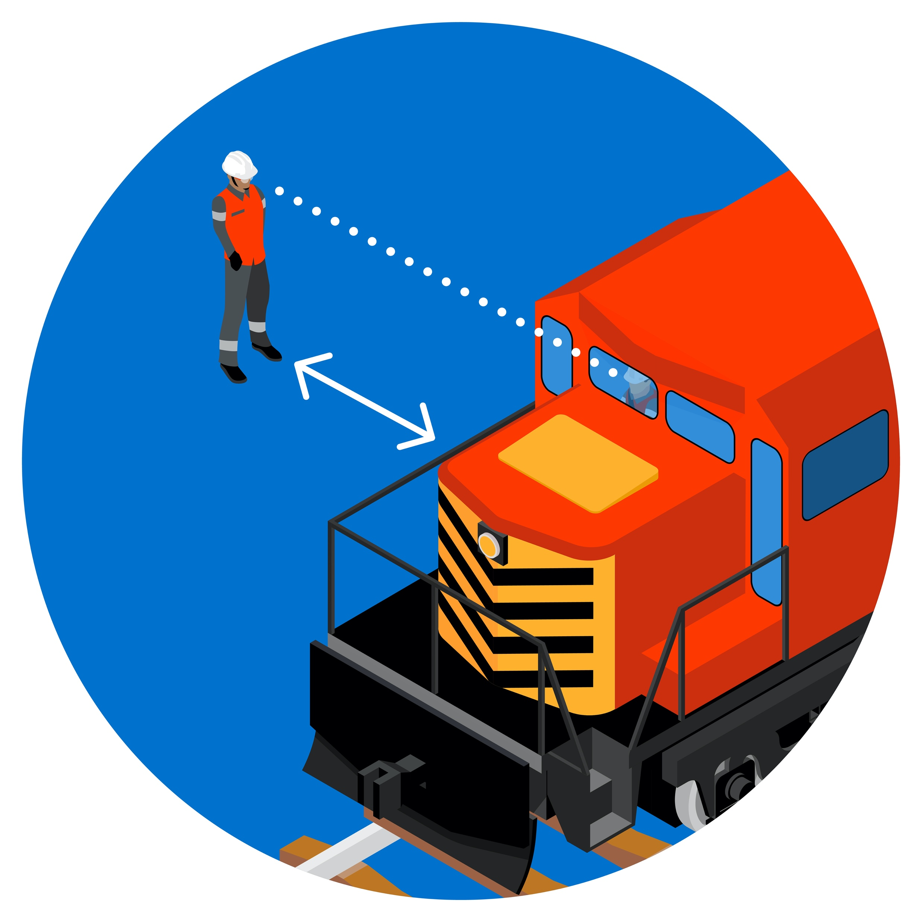
Life Saving Golden Rules
Respect them to stay alive
I respect rail priority and stay out of close clearance areas
Involved in 7 fatal events since 2017
Practical examples of expected behaviours:
I understand and identify railway hazards, including cranes on rails and transfer cars on rails
I stay out of close clearances if the rail track has not been isolated
I stay 3m away from a still wagon or loco when I need to cross a railway
I never put myself between 2 buffers
When driving a rail vehicle, I respect the line of sight rule at all times, and all railway operation rules

Slide 9
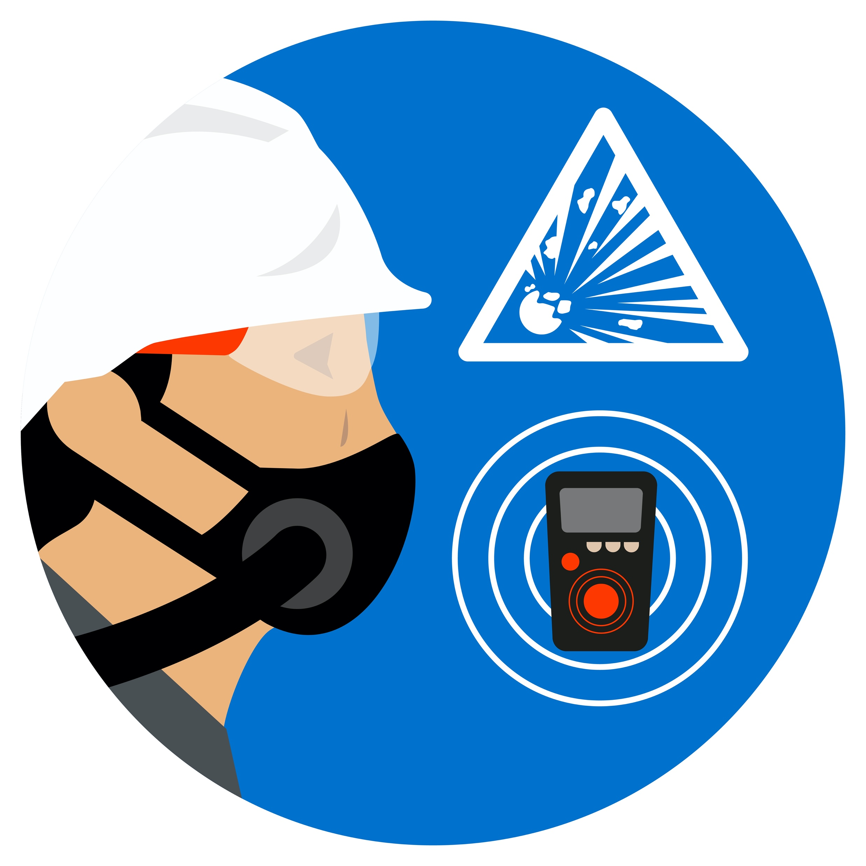
Life Saving Golden Rules
Respect them to stay alive
I respect the rules for entering and working in hazardous gas areas
Involved in 5 fatal events since 2017
Practical examples of expected behaviours:
I understand and can identify gas hazards
I understand and use the controls foreseen by the risks analysis, at all times
I wear an individual gas detector and ensure it is operational at all times
I understand and respect gas detector alarms and corresponding evacuation rules

Slide 10
Life Saving Golden Rules
Respect them to stay alive
I never disable safety devices
Involved in 1 fatal event since 2017
Practical examples of expected behaviours:
I always put back in place safety devices at the end of the work and check their effectiveness before removing my personal lock
I speak up if a safety device is damaged or misfunctioning
If absolutely necessary to temporarily override or disable a safety device, I first obtain my leader’s written authorisation, I perform a specific corresponding risks analysis, and I implement its controls (for example exclusion zones)

Slide 11
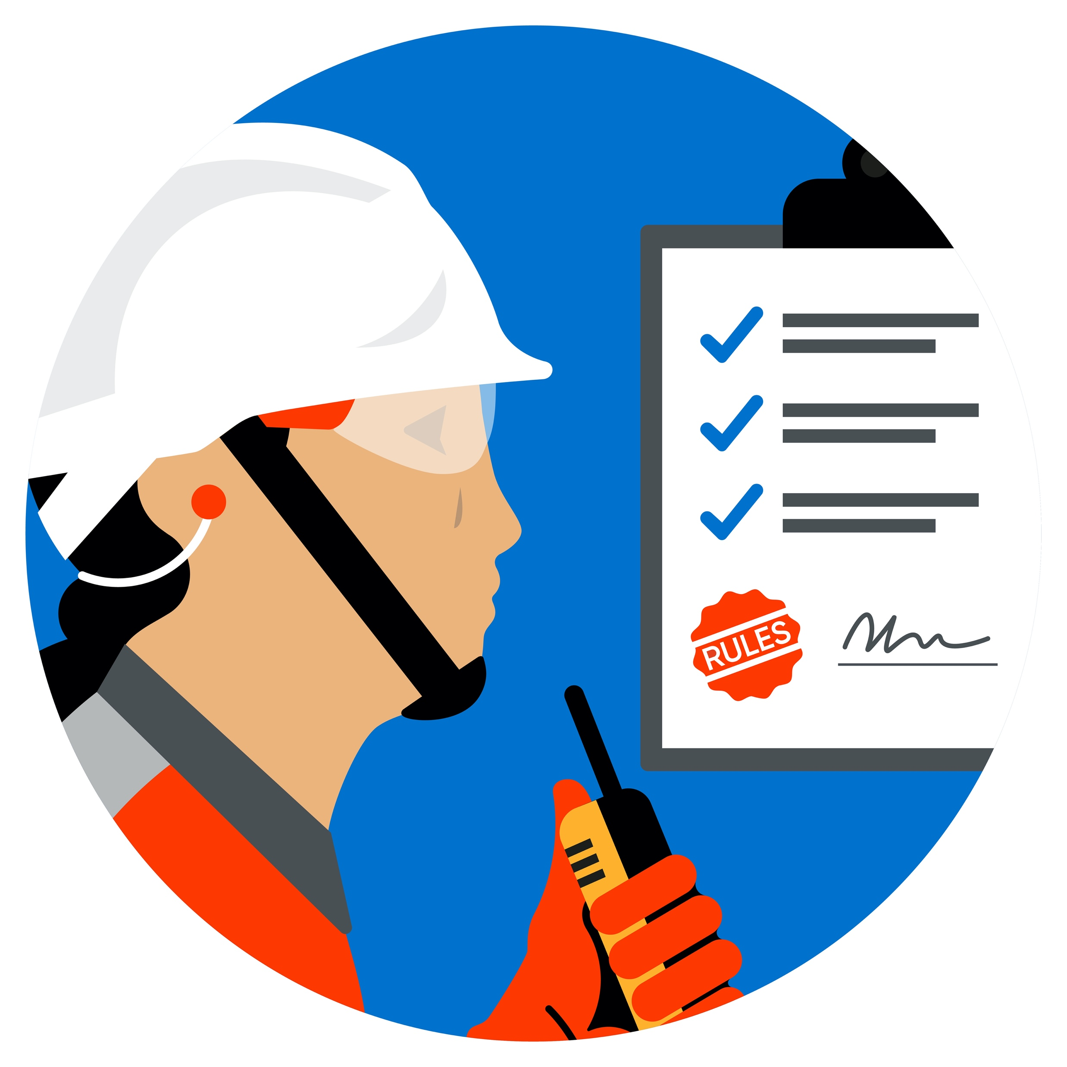
Life Saving Golden Rules
Respect them to stay alive
I respect all the H&S rules, standards and signals and I wear the required PPE
Involved in 32 fatal events since 2017
Practical examples of expected behaviours:
I respect all the risks controls according to the job risks analysis and Standards Operating Practices
I obtain a work permit, when required, before starting the job
I ask questions if something is unclear
I communicate clearly and use 3-way communication for critical messages
I scan my environment for hazards and practise shared vigilance
I immediately STOP the work and speak up when a life saving golden rule is not respected

